Slide 1
Finding Relationships Between Chronic Illness and Weather Patterns with Flaredown App Data
Health Data Sci Prof Dev: Group 1
Presenters: Allison HyunJo Park, Parinitha Kompala, Taylor Hudson, Zhaofeng liu

Slide 2
BACKGROUND AND INTRO

Slide 3
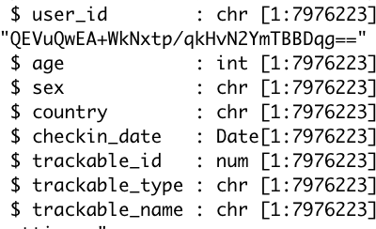
INTRODUCTION
It has long been accepted that symptom flare-up can be influenced by weather. Patients with chronic pain frequently feel that their discomfort is caused by the weather.
Flaredown is an app that helps chronic autoimmune and invisible illness patients manage their symptoms by avoiding triggers and reviewing their medicines. Patients keep track of their symptom intensity, therapies and doses, as well as any potential environmental triggers (foods, stress, allergens, etc.) each day.
This is the structure of our dataset.
Notes:
Pari-So took the dataset from kaggel.Though we have like 79… row, there are duplicates , as each person can entered like multipl eobservations. So after removing all the duplicates we had 42283 observations.

Slide 4
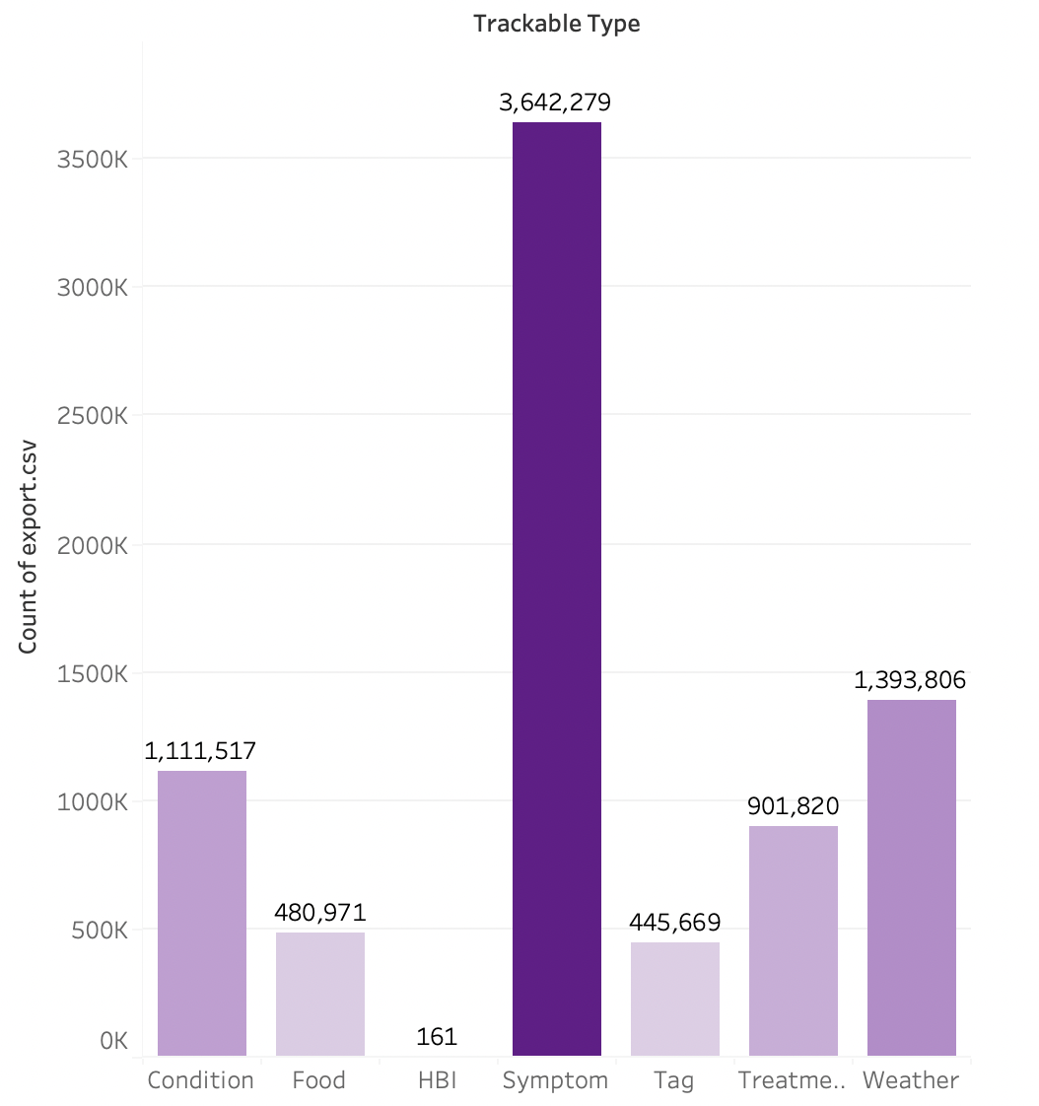
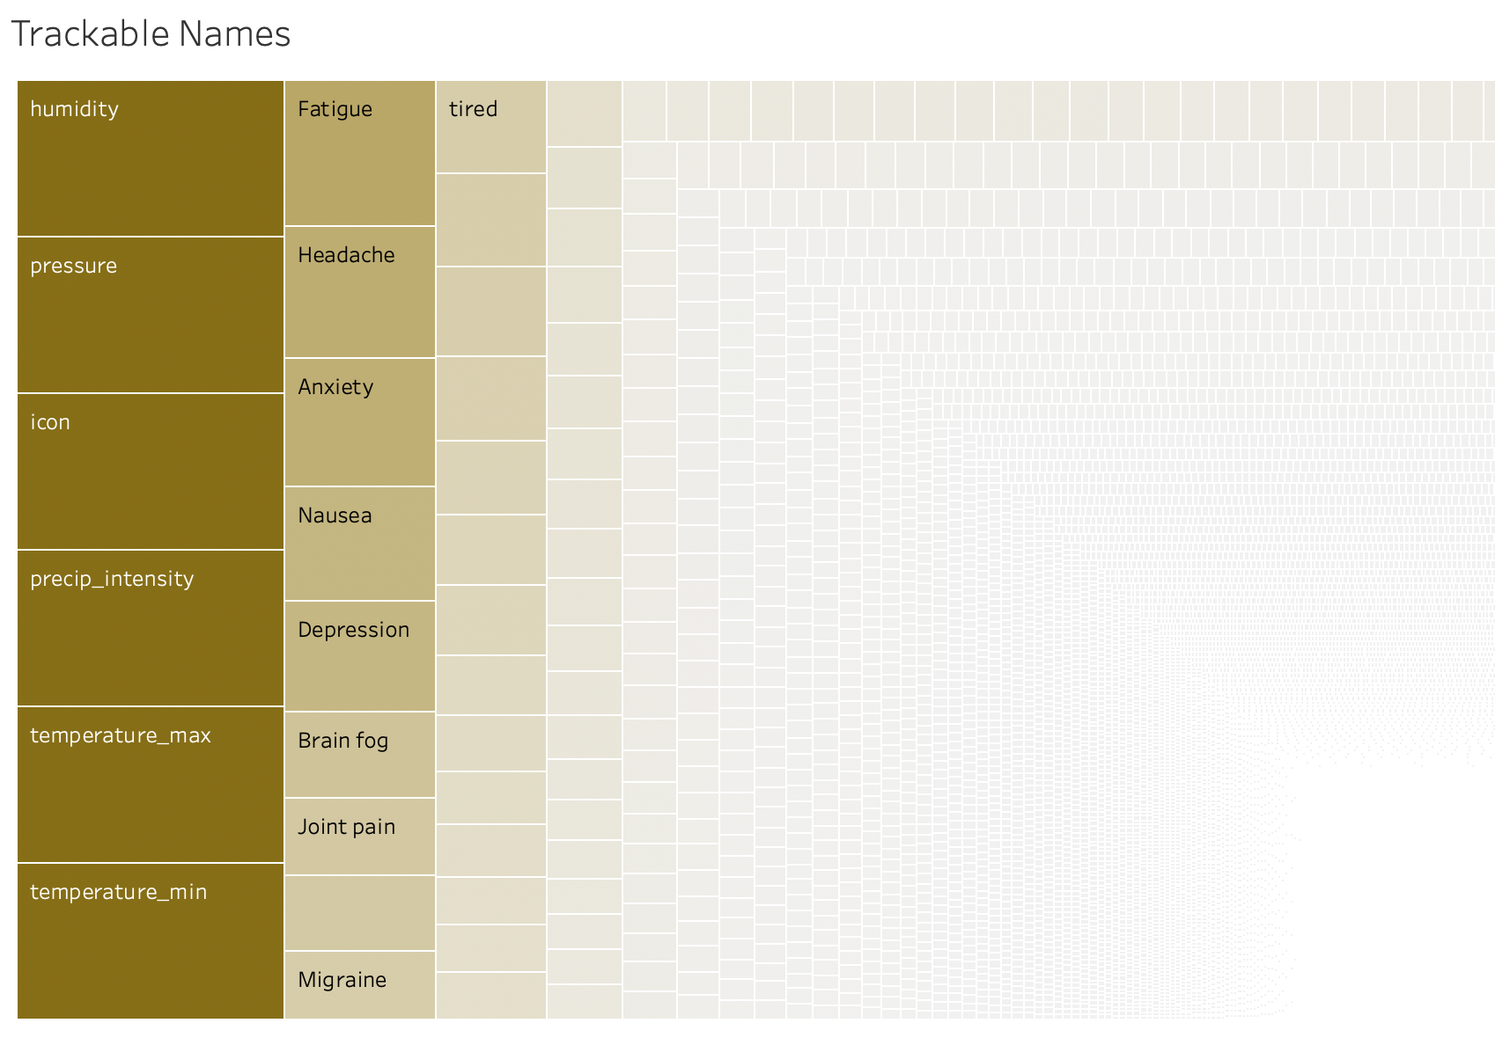
Clear View On the essential variables

Slide 5
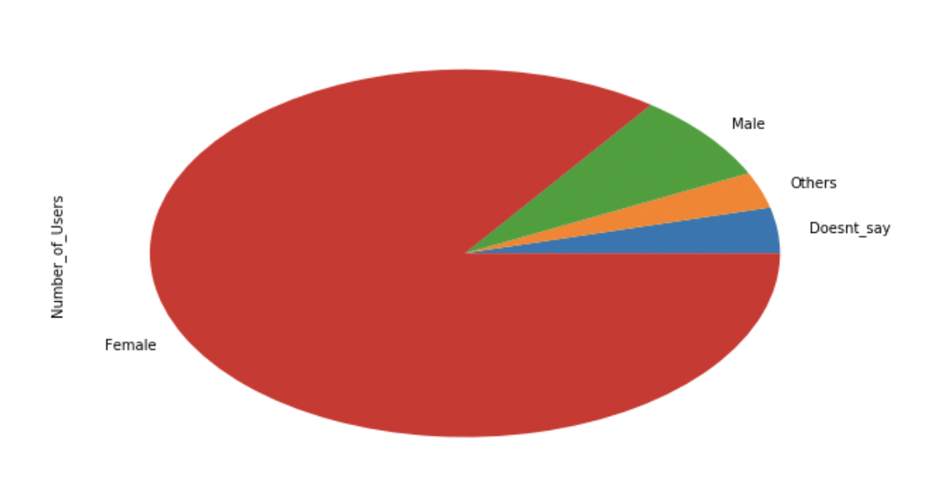
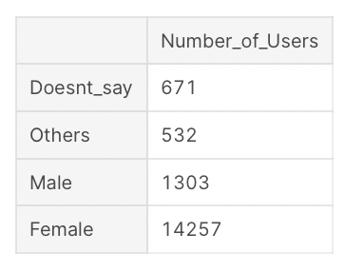
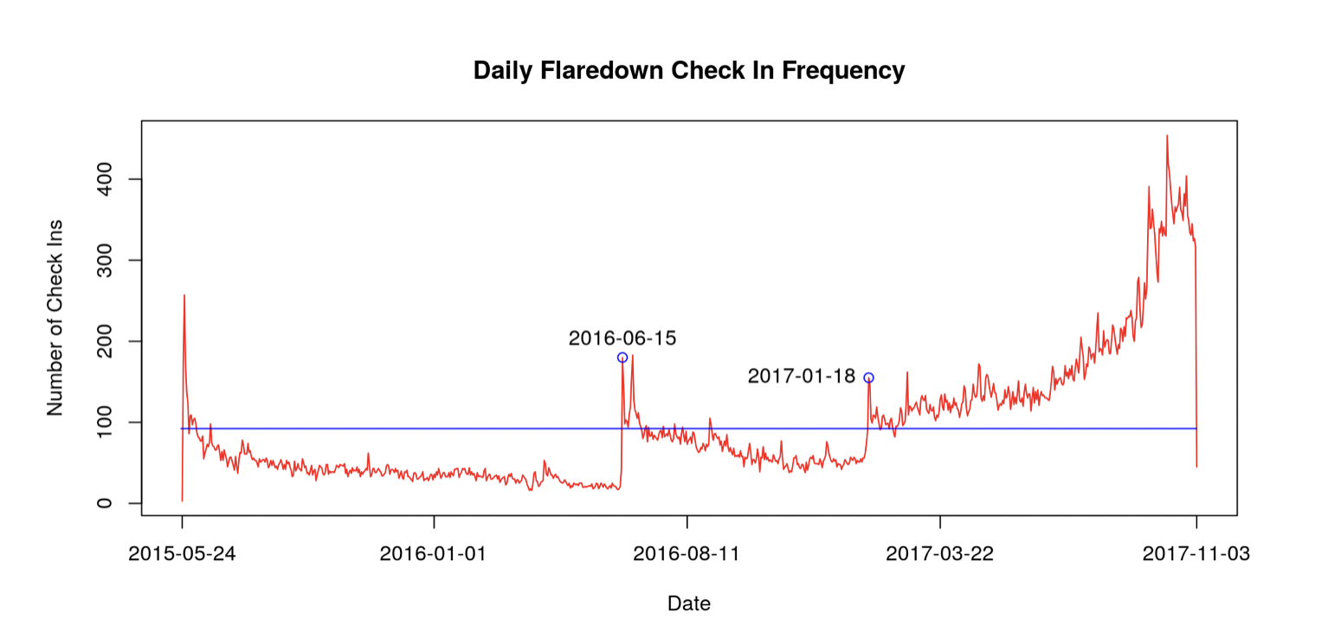

Slide 6
STATISTICAL ANALYSIS

Slide 7
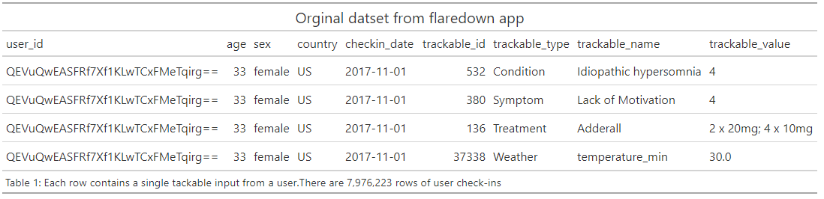
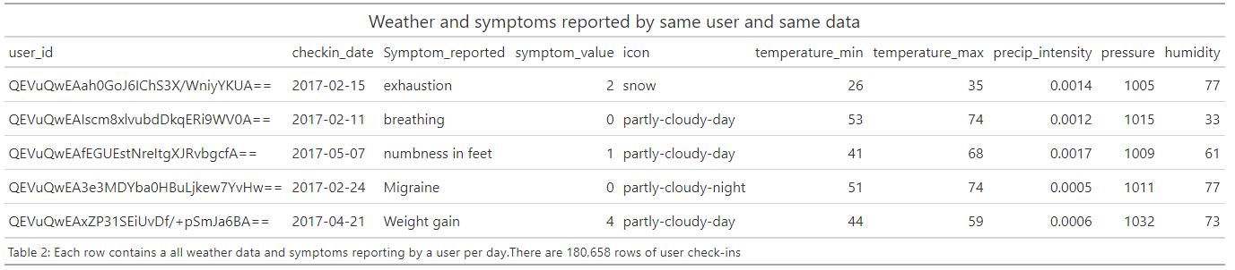
Statistical Analysis: Data wrangling
Same user
Same date
Weather
conditions
Symptom Reporting
Notes:
Taylor

Slide 8
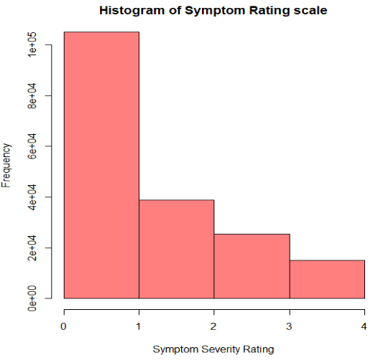
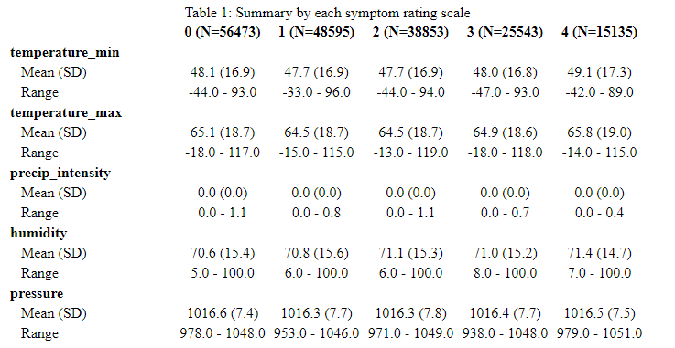
Statistical Analysis: variables and hypothesis
Dependent variable:
  Rating of symptom severity on a 1-4 scale, ordinal
Predictor variables:
  Atmospheric pressure, continuous
  Weather icon, nominal
  Humidity, nominal
  Precipitation intensity, continuous
  Temperature, continuous
Potential influencers/effect modifiers or confounders
  Treatment, nominal
  Sex, binominal
  Age, ordinal
H_{o} = There is no change in the frequency of symptom reporting when there is increased atmospheric pressure, increased humidity and days with precipitation.

Slide 9
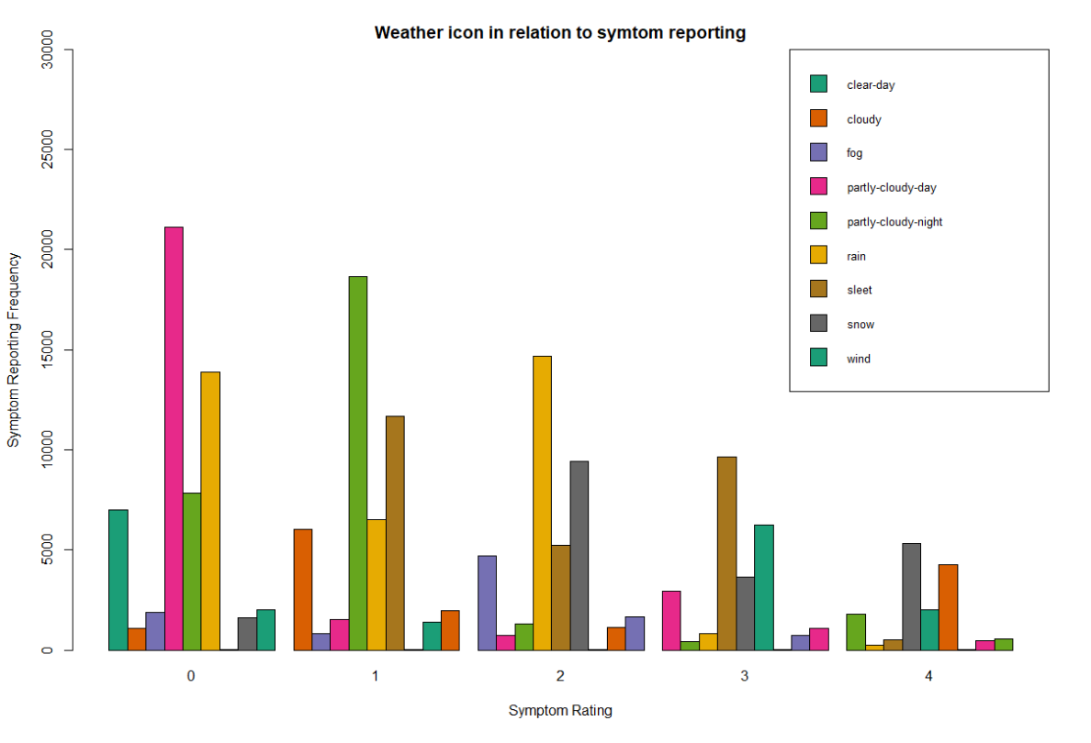
Statistical Analysis: modeling
Ordinal Logistic Regression:
Assumptions:
Ordinal dependent variable
proportional odds → that each independent variable has an identical effect.
No strong correlation between variables
Model output:
coefficients → can be converted to odds ratio with CI
Standard Error
t-statistc → coef / std. error, shows if coef is statistically different than 0
P-value
Model Fitness:
Compare observed and expected values
Pearson goodness of fit
Check interactions between variables by adding them as interactions

Slide 10
MARKET RESEARCH
Notes:
Allison

Slide 11
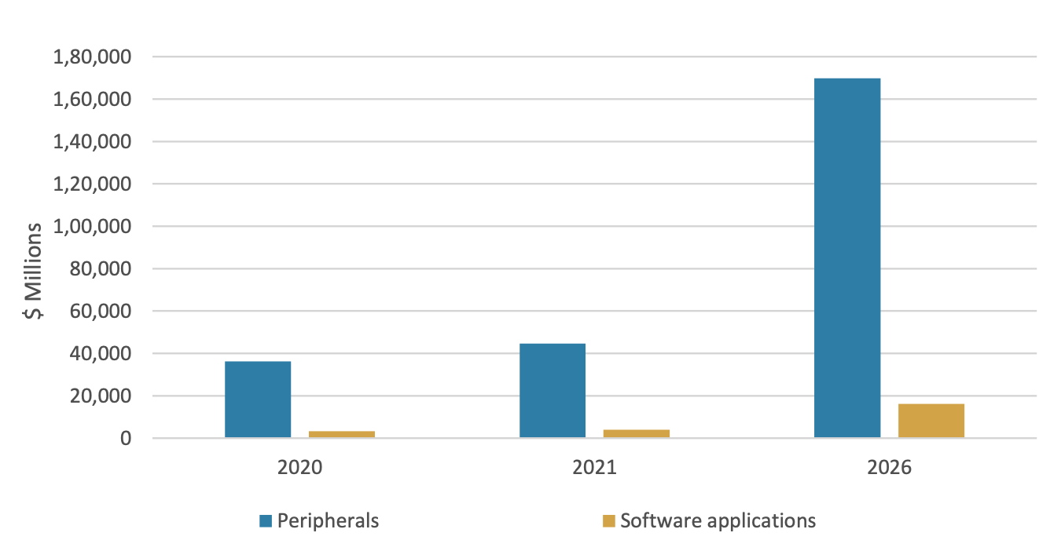
Industry trends in telehealth applications
Advancements in medicine and PH + changing lifestyles → more market growth
Global mHealth market was valued at
$50.7 billion from $13.2 billion in 2016
BCCResearch Library
  “Technologies for Long-term Care and Home Healthcare: GlobalMarkets”
  “Health Self-monitoring: Technologies and Global Markets”
  “Mobile Health (mHealth) Technologies and Global Markets”
Resource: https://academic-bccresearch-com.dartmouth.idm.oclc.org/market-research/healthcare/health-self-monitoring-technologies-markets-report.html
https://academic-bccresearch-com.dartmouth.idm.oclc.org/market-research/healthcare/long-term-care-home-healthcare-technologies-markets-report.html
Notes:
Medical science and technology are continuously evolving for the betterment of mankind and the healthcare industry. Medicine and public health, along with increased consciousness about nutrition, environmental impact, and personal hygiene have led to a sharp increase in life expectancy, globally. Advancements and changing lifestyles encourage market growth.
Changing lifestyles : increased consciousness about nutrition, environmental impact, and personal hygiene

Slide 12
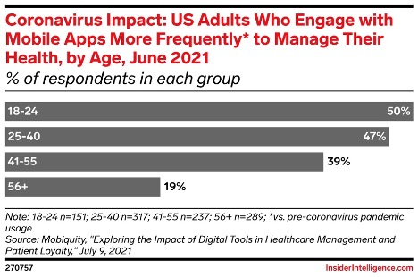
Use of mHealth for illness management
90% of the US’ $3.8T in annual healthcare expenditures is for people with chronic and mental health conditions
59% of chronic condition patients use their phones regularly to manage their health and wellness, the highest percentage among multipurpose devices
37% of patients across all age groups are using a mobile app to manage their health more frequently now than before the pandemic
eMarketer
  Mobile Health Apps for Disease Management: Patients Turn to Smartphones for Condition-Specific Help
Resource: https://content-na1.emarketer.com/mobile-health-apps-disease-management
Notes:
Smartphones have become a go-to device for health condition management.
*** this can show – margin of error from people not recording their symptoms daily
mHealth apps in three condition-specific categories are becoming most prevalent:
§Diabetes §Mental and behavioral health §Heart disease

Slide 13
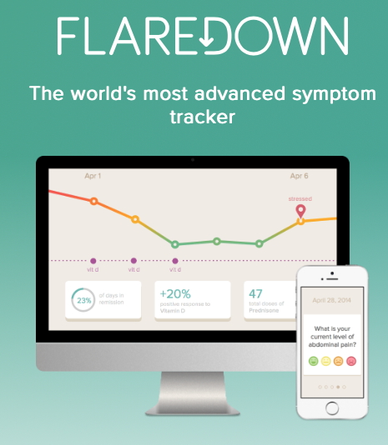
Key takeaways
Disease management health apps are rising to prominence
Smartphones have become a go-to device for health condition management
Majority of chronic illness patients use apps to regularly to manage their health and wellness
Implications on our data!

Slide 14
LITERATURE SURVEY

Slide 15
Original RQ: Using data from a symptom reporting app, Flaredown, is there a relationship in weather conditions and/or eating habits that correlate to a higher frequency of symptom reporting. If so, can we use this weather data as a predictor for increased symptom reporting?
what we change: We were able to narrow down our research question that we previously had by dropping the food effects and eating habits factors. And adding the age effects in to our RQ.
Current RQ: Using data from a symptom reporting app, Flaredown, is there a relationship in weather conditions and/or age effects that correlate to a higher frequency of symptom reporting. If so, can we use this weather data as a predictor for increased symptom reporting?
Literature Survey
Notes:
Zhoafeng

Slide 16
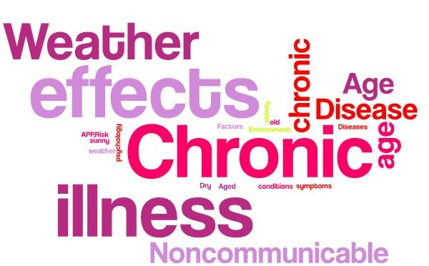
Subject Headings
Chronic illness: ("Chronic Disease"[MeSH] OR "Noncommunicable Diseases/psychology"[MeSH] AND "Risk Factors"[MeSH] OR “Outdoors Environment"[MeSH]
Weather: ("Weather"[MAJR]) AND "Chronic Disease"[MeSH]
Age effects: ("Weather"[MAJR]) AND elderly[TI] OR “Aged”[MAJR]
Resources: PubMed
Text Words
Chronic illness: chronic illness[tiab] AND symptoms[tiab]
Weather or food effects: weather conditions[tiab] OR sunny[tiab]
Age effects: age[tiab] OR old age[tiab] AND chronic illness[tiab]

Slide 17
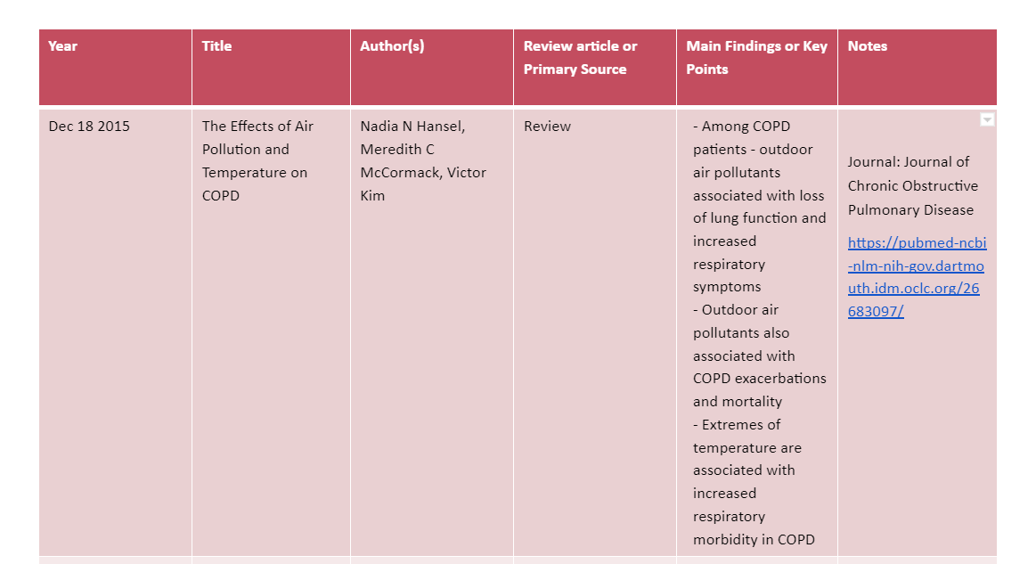
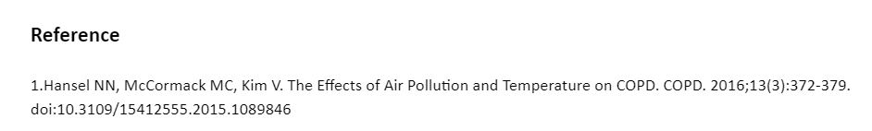
Literature Matrix

Slide 18
THANK YOU !

